Slide 1
Tembo Hotel Business Analytics Report

Slide 2
Introduction
Group Members
Caleb
Linda
Susan
Darre
Michel
Business Problem
The hotel management needed help understanding revenue trends, occupancy performance, staff productivity, and guest satisfaction using data analytics.
Objective
Our goal was to clean the hotel data, analyze it using PostgreSQL, and build interactive Power BI dashboards for business decision-making.

Slide 3
Data
The Tembo hotel dataset had booking id, guest information, staff information and Revenue.
Problems Found in the Data
Duplicate records eg BKOOO6
Wrong text case
Inconsistent payment method
Wrong phone formats
Notes:
The dataset was highly inconsistent and required extensive cleaning before analysis.

Slide 4


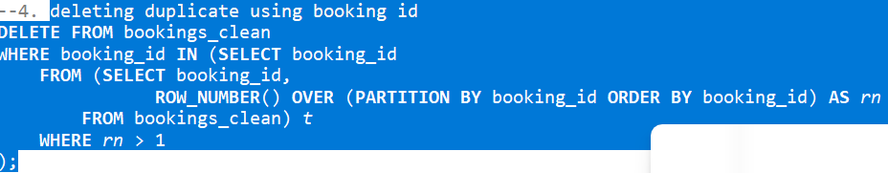
Data cleaning
Standardizing Names
2. Trim
3. Deleting duplicates

Slide 5
Which Rooms Make the Most Money?
Deluxe and Suite rooms generated the highest revenue.
Which Months Are Busiest?
December and July had the highest number of bookings, showing peak travel seasons.
Staff performance- Kelvin followed by Moses
If guests are happy Average rating of 3
Most guests reported positive experiences, indicating strong service quality.

Slide 6
Recommendation
Increase marketing for Deluxe and Suite rooms since they generate the highest revenue.
Prepare additional staff during peak months such as December and July.
Have clear and correct banking details since bank transfers are most used

